Slide 1
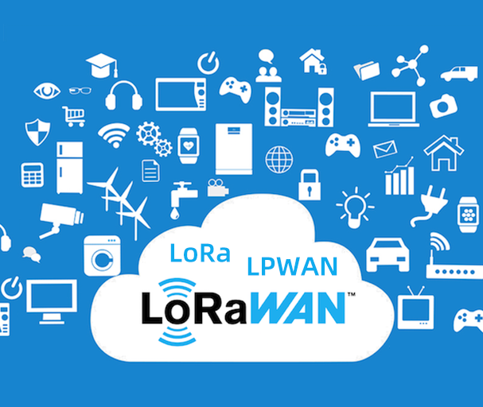
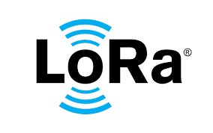


LoRa Training

Slide 2
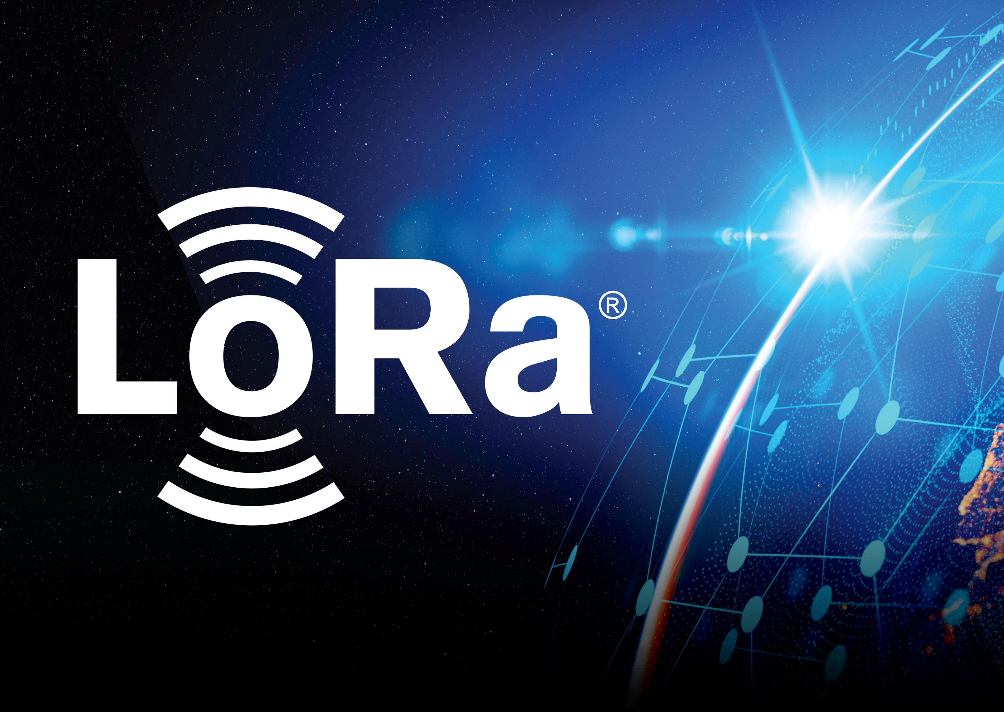
WHAT IS LORA?
LoRa which stands for Long Range, is a wireless communication technology designed for long-range communication between devices with low power consumption. LoRa operates in the Industrial, Scientific, and Medical (ISM) radio bands, and it is often used in Internet of Things (IoT) applications.
What are the industrial scientific and medical ISM bands?
The industrial, scientific and medical (ISM) radio bands are frequencies reserved internationally for the use of radio frequency (RF) energy for industrial, scientific and medical uses for other purposes other than telecommunications

Slide 3
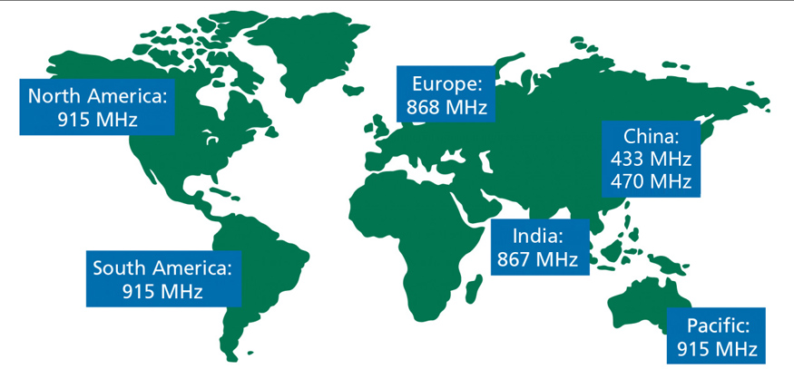
LoRaWan Frequency Plans

Slide 4

Key features of LoRa include:
Long Range: LoRa devices can achieve communication ranges of several kilometers, making it suitable for applications where devices are spread out over a large area.
Low Power Consumption: LoRa devices are designed to operate on low power, making them suitable for battery-powered devices with long battery life.
Low Data Rate: LoRa is optimized for low data rate communication, which is sufficient for many IoT applications. This helps in conserving power and extending the range.
Bi-directional Communication: While LoRa supports both uplink and downlink communication, the uplink (device to gateway) is more common in many IoT use cases.
Scalability: LoRa networks can be easily scaled to accommodate a large number of devices within a given coverage area

Slide 5
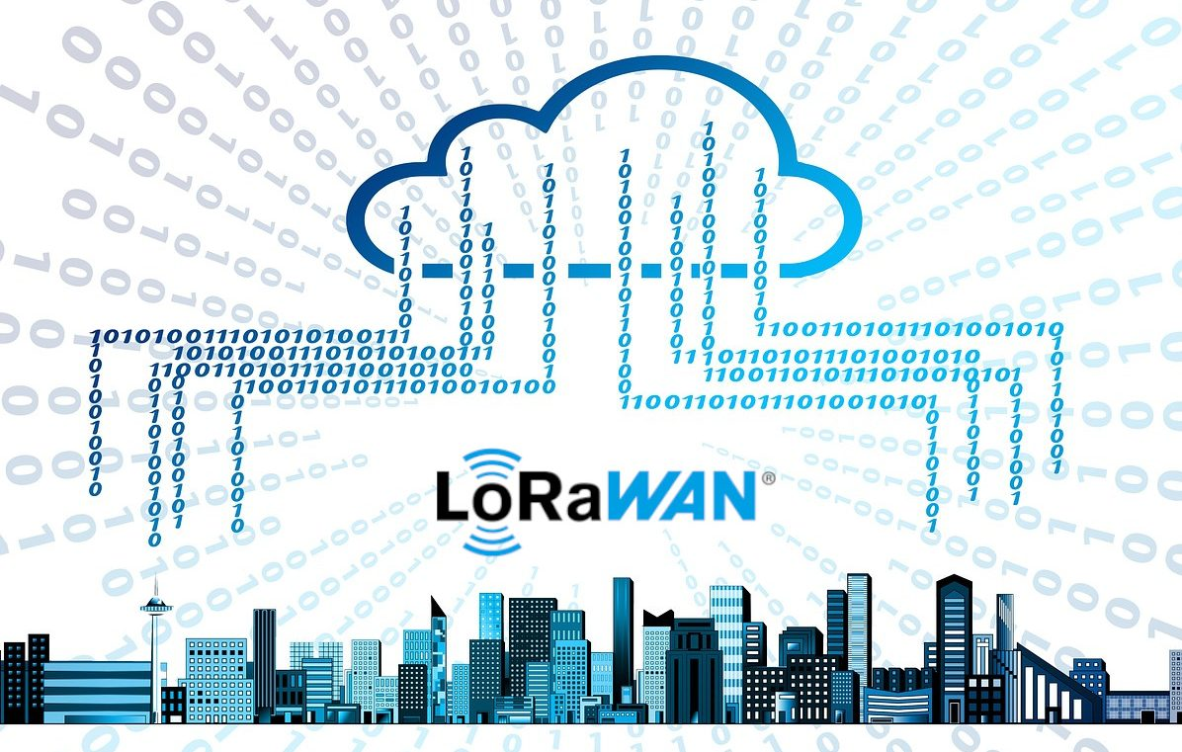
LoRaWAN
LoRaWAN (LoRa Wide Area Network) is a protocol built on top of LoRa technology, providing a standardized way for LoRa devices to communicate with network gateways and connect to the internet. LoRaWAN enables the creation of large-scale, low-power, and cost-effective IoT networks.

Slide 6
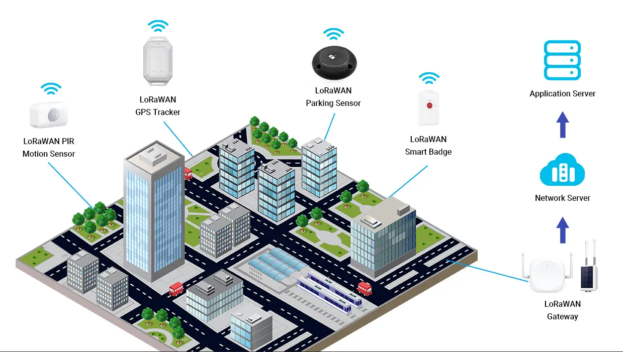
LoRaWAN

Slide 7
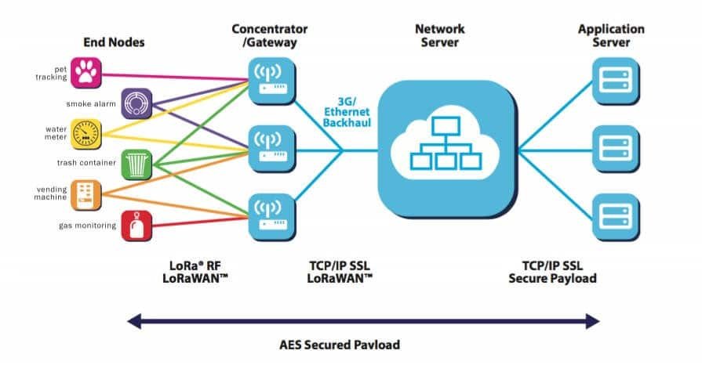
LoRaWAN

Slide 8

STEPS TO SUCESSFUL LORAWAN
Gateway registration
Gateway configuration
Create application
End device configuration

Slide 9
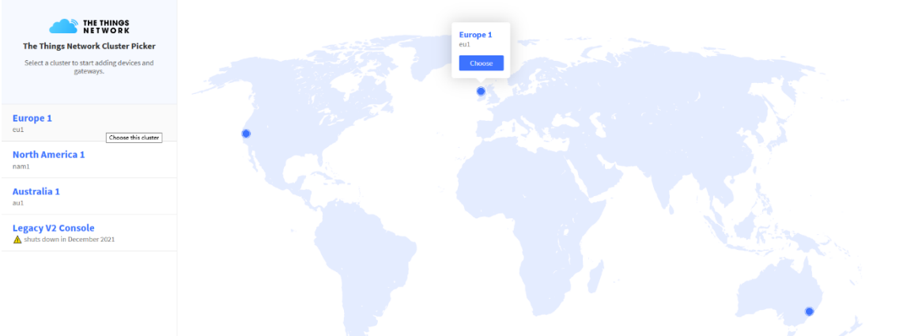
Gateway Registration
Sign up user account https://id.thethingsnetwork.org/oidc/interaction/AwFHU9WCxQvSAtWUCWnQy

Slide 10
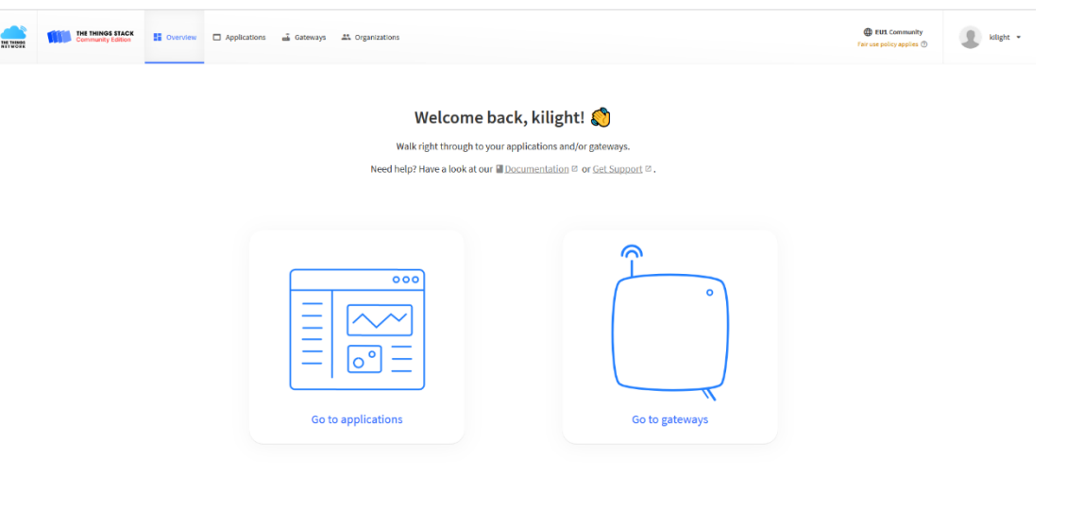
CREATE GATEWAY

Slide 11
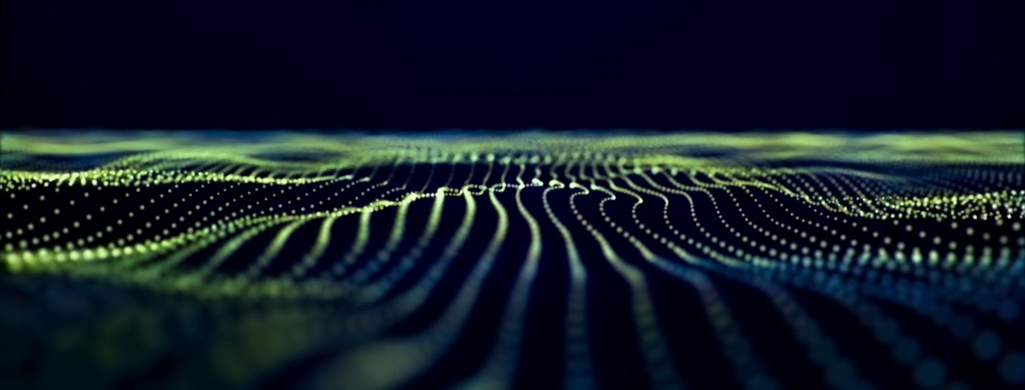
Gateway registration
Gateway EUI
Name or ID (or both)
Region (frequency plan)

Slide 12
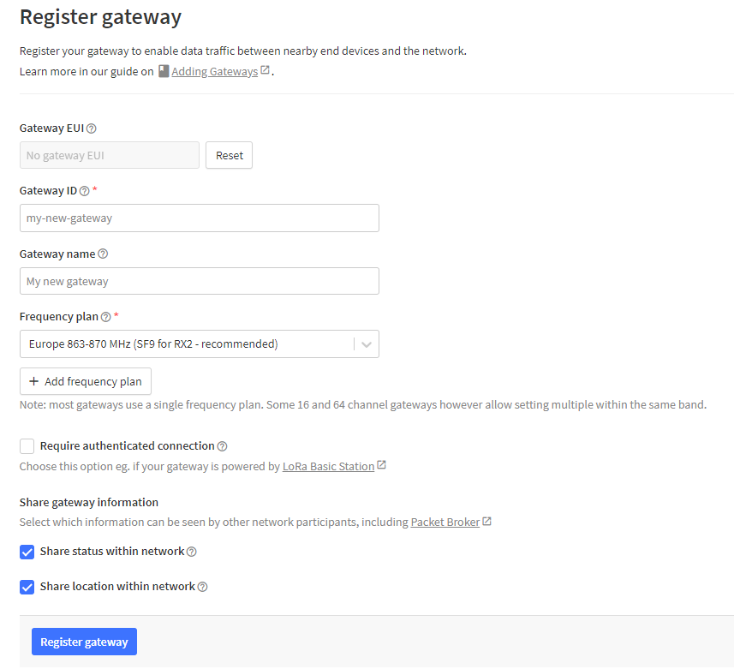
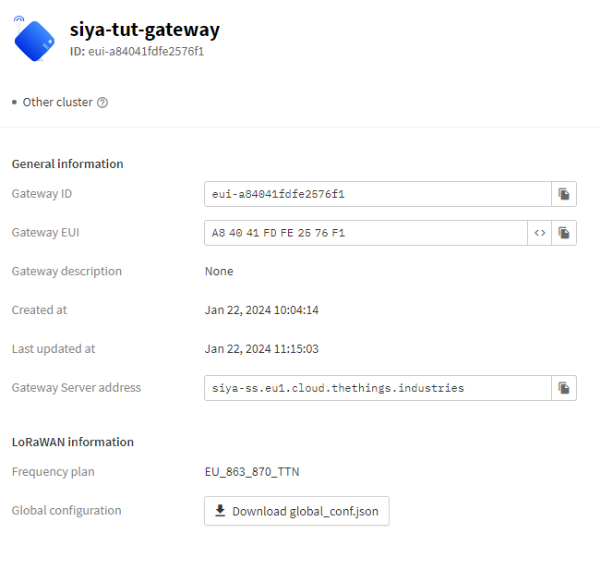

Slide 13
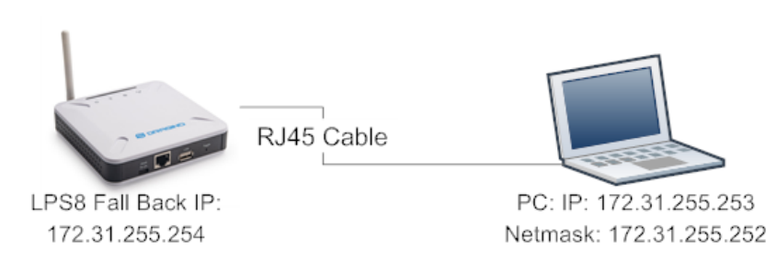
Gateway configuration
Log in Dragino:

Slide 14
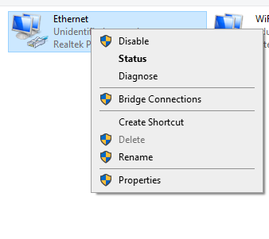
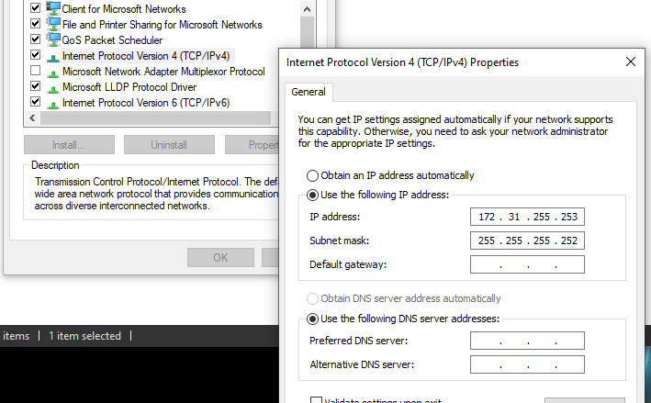
Use http://172.31.255.254/ to open Dragino web Ui

Slide 15
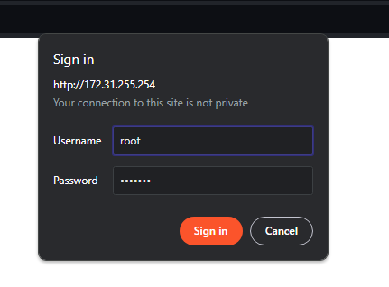
LOGIN
Username: root
Password: dragino

Slide 16
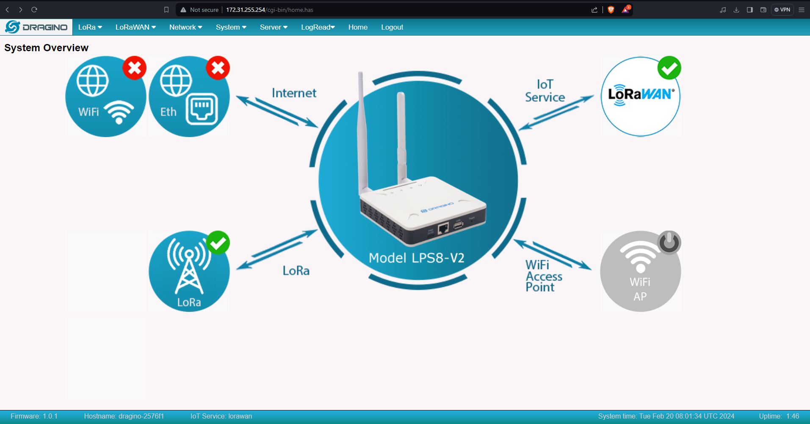

Slide 17
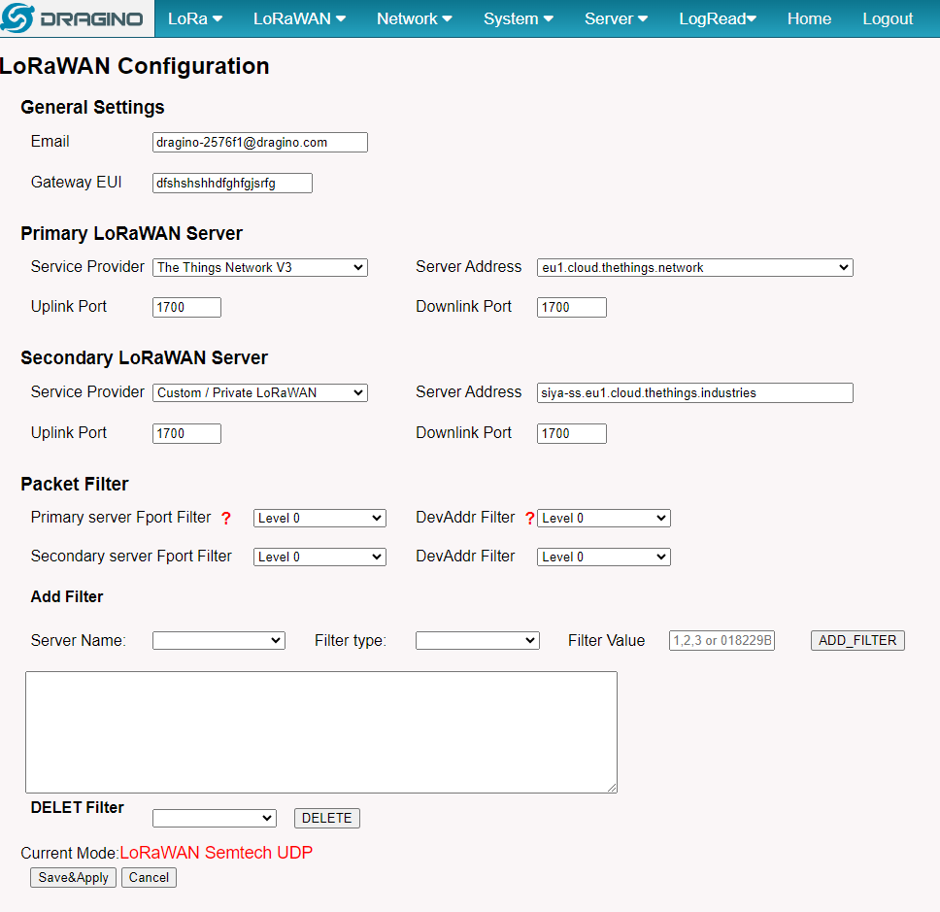
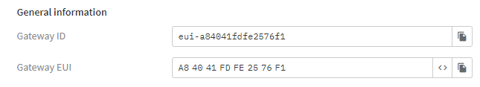
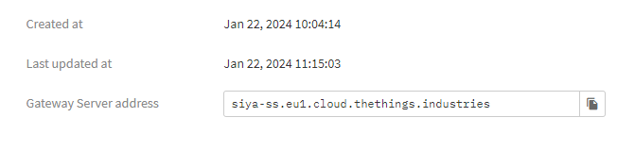
Same server address as TTN network
Same server address as TTN network

Slide 18
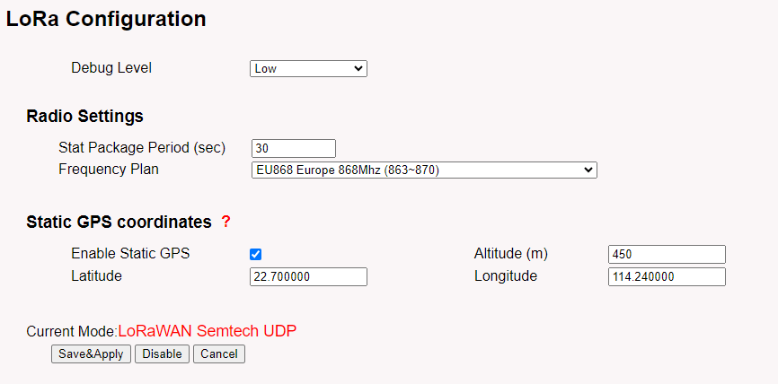
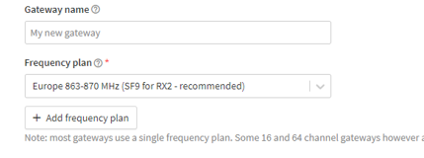
They must be the same TTN as well Dragino gateway

Slide 19
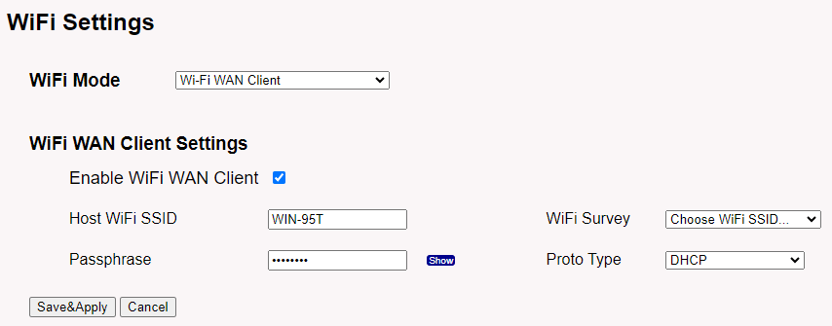
Setup WIFI which gateway will use to transfer data to TTN.

Slide 20
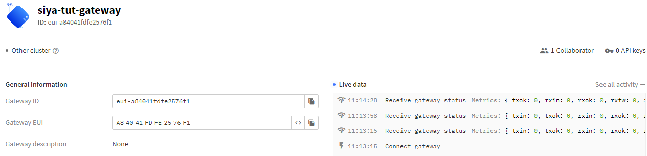
Successfully connected Gateway

Slide 21
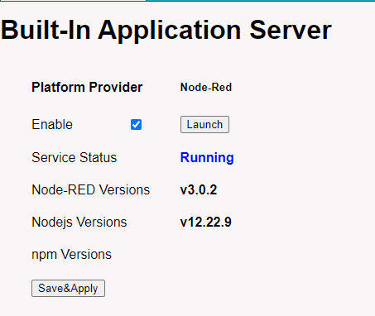
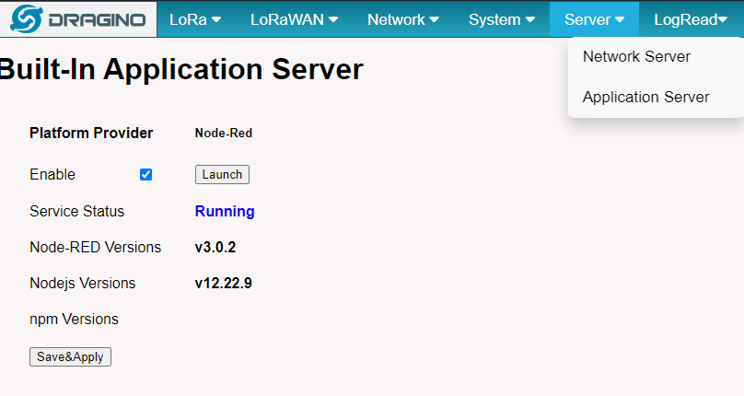
Run The following servers

Slide 22
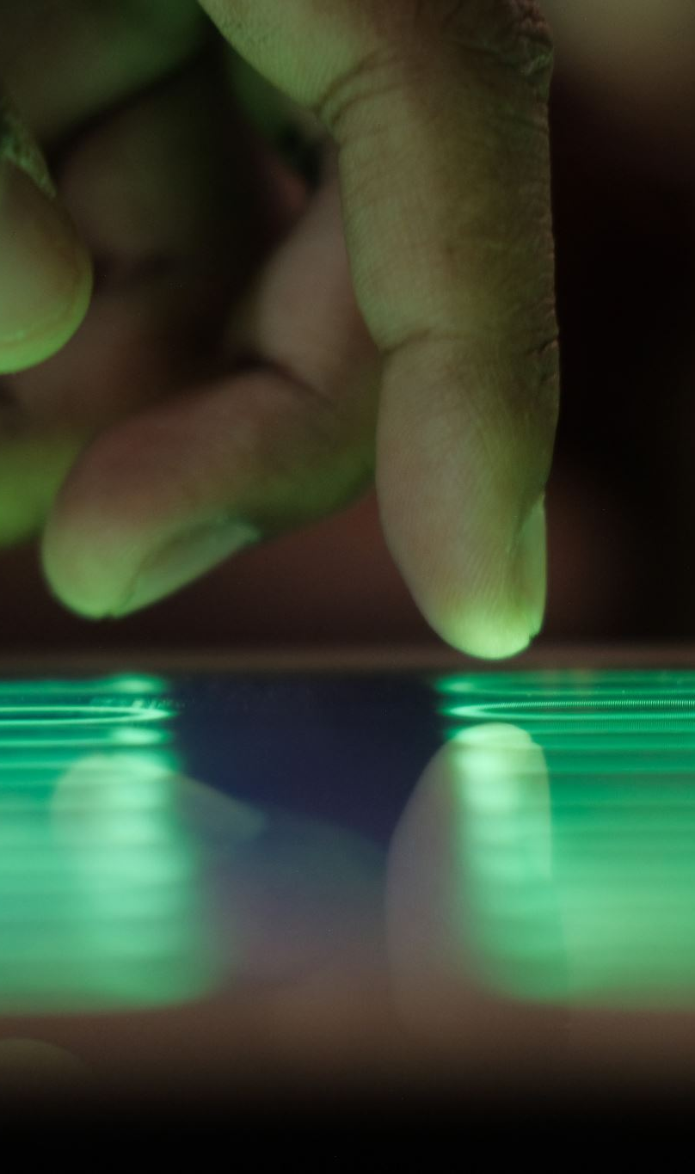
CREATING APPLICATION
To add LoRaWAN END device you need TTN application

Slide 23
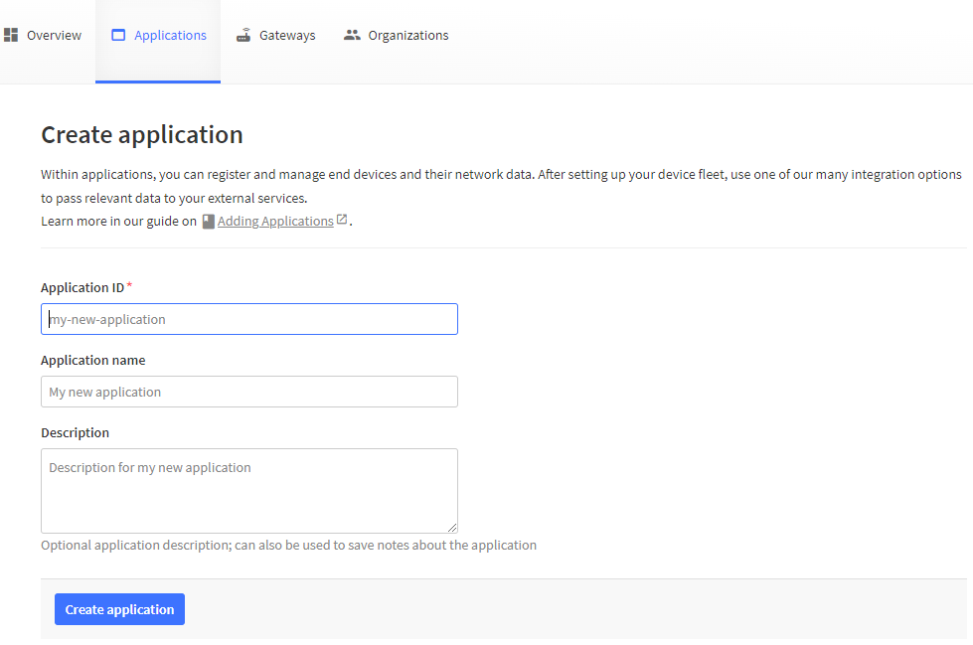

Slide 24
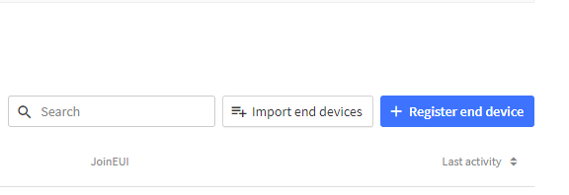
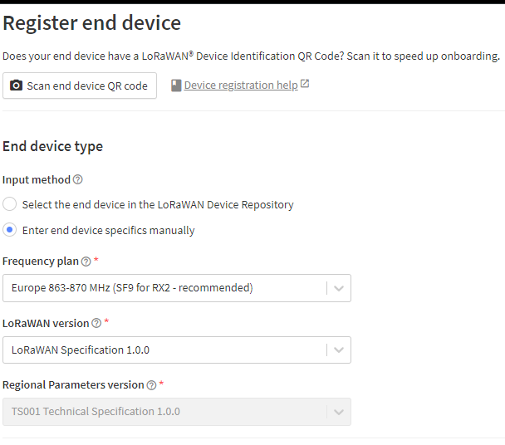
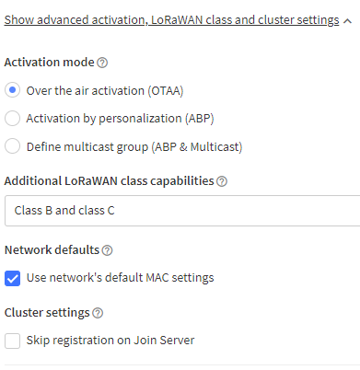
Adding End Device

Slide 25
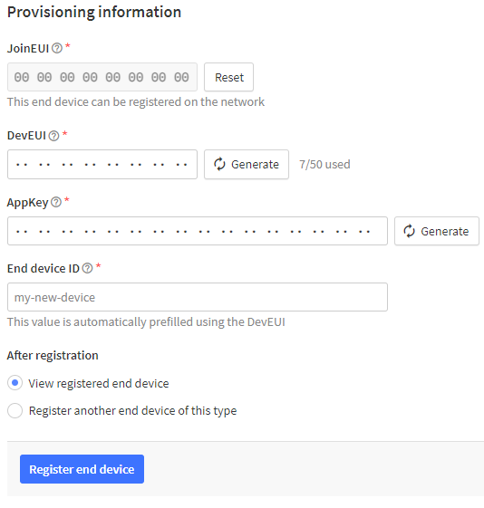
Generate: DevEUI, AppKey or provide from the device datasheet.

Slide 26
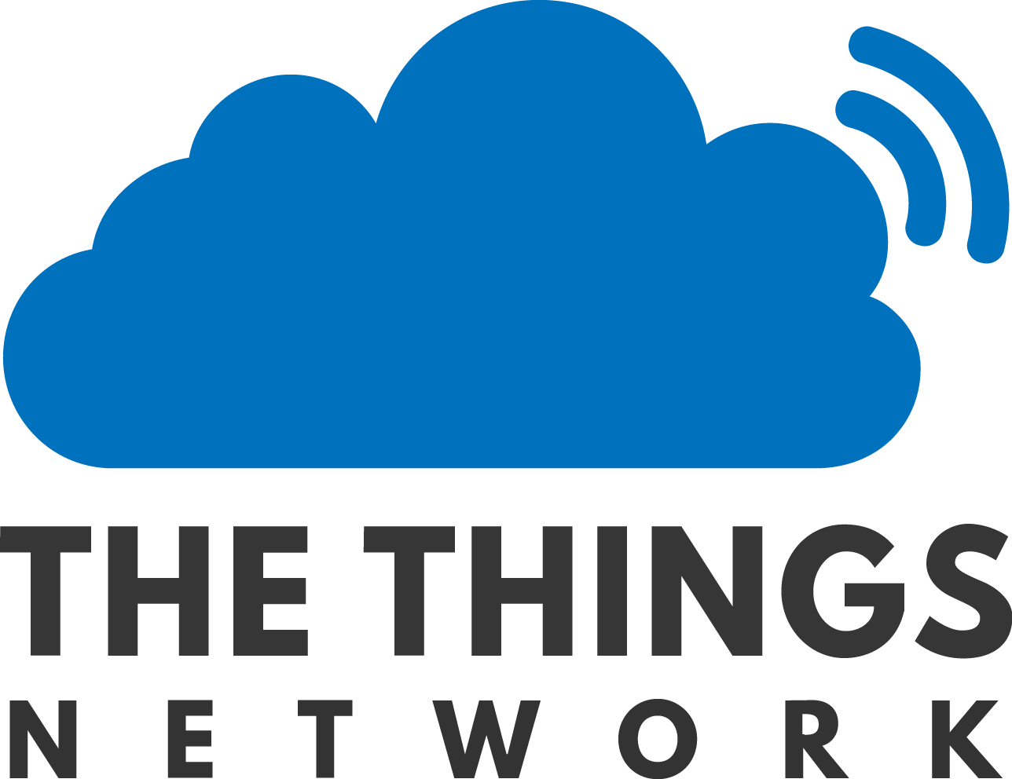
Exporting data from the LoRaWAN Server

Slide 27

How to get Data from TTN Network
Integrations are used to get data from TTN:
MQTT
Webhooks
Storage Integration
AWS IOT
Azure IOT
Lora Cloud

Slide 28
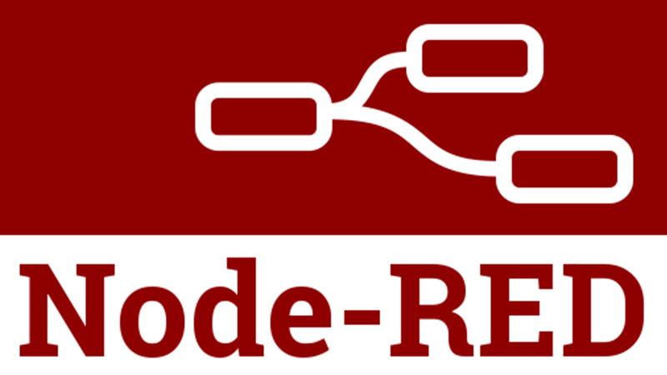
MQTT
Node-RED is a flow-based, low-code development tool for visual programming developed originally by IBM for wiring together hardware devices,
Node-red has MQTT feature which is used to get data from TTN to node-red which can later be pushed to a database and create a dashboard to visualise the data.

Slide 29
Setup Node-RED
Install node.js and Node-RED
curl -sL https://deb.nodesource.com/setup_12.x | sudo -E bash -
sudo apt-get install -y nodejs build-essential
sudo npm install -g --unsafe-perm node-red
Node-RED to start automatically whenever your instance is restarted
sudo npm install -g --unsafe-perm pm2
pm2 start `which node-red` -- -v
pm2 save
pm2 startup
Start node-red manually
SSH the instance
Write command:
node-red

Slide 30
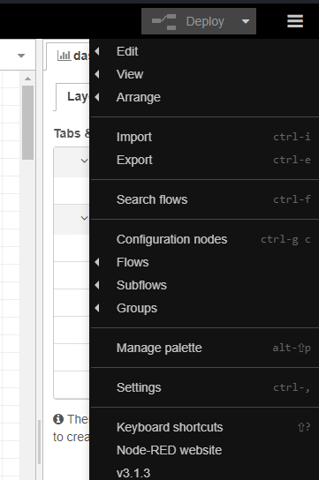
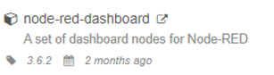
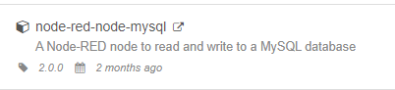
Install packages on node-red
Click manage palette
Install
install dashboard
Click manage palette
Install
install dashboard

Slide 31
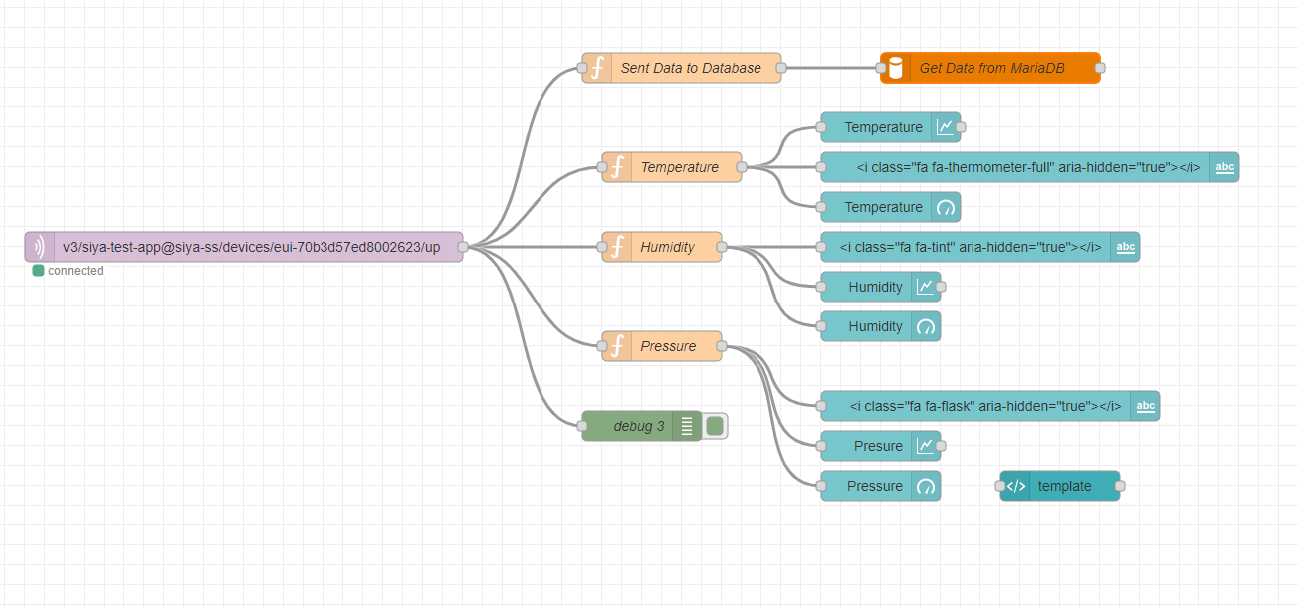
Node-red Flow diagram

Slide 32
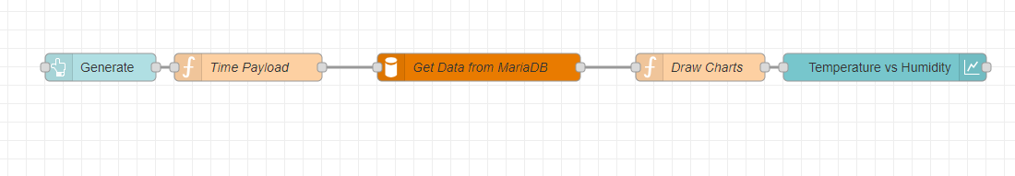
Getting Data From Database

Slide 33
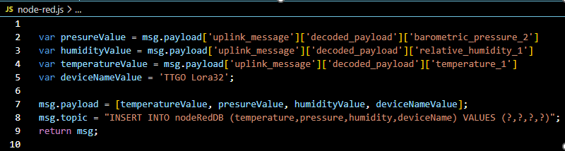
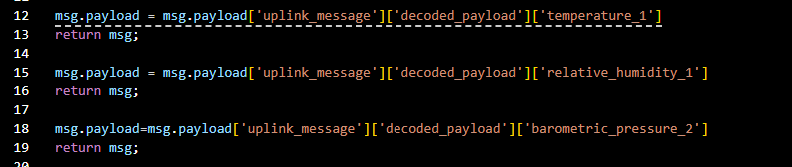
Code for node-red
Get data from TTN using MQTT node follow the path by pointing where data is located from the formatted payload then insert the data to database.
For displaying real time data on the dashboard, we then get data from the same payload then we can use it to draw charts, displaying the data.

Slide 34
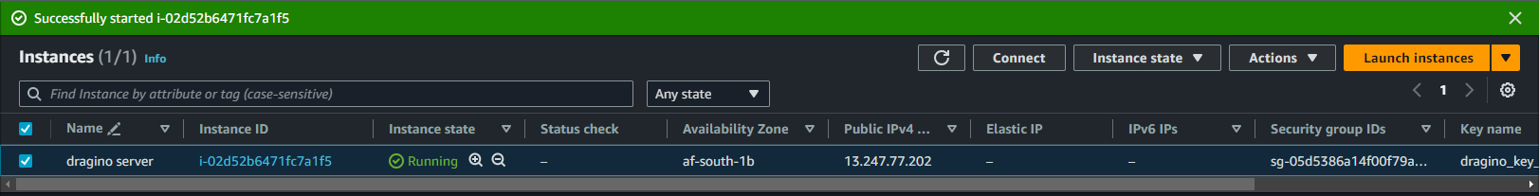
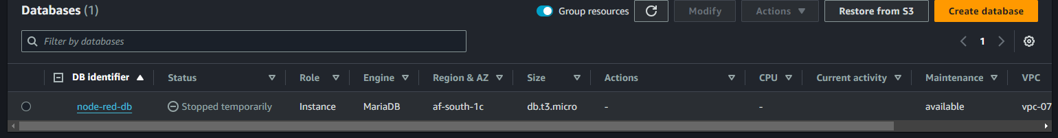
AWS EC2 instance and RDS Database
For allowing the dashboard to be viewed on any device with network I installed node-red AWS which later can turn

Slide 35
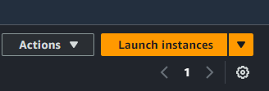
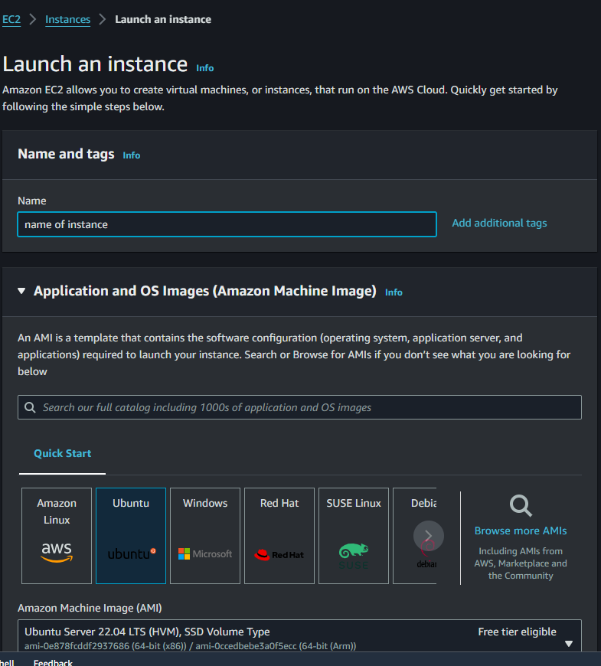
Creating instance for node-red
Select ubuntu AMI

Slide 36
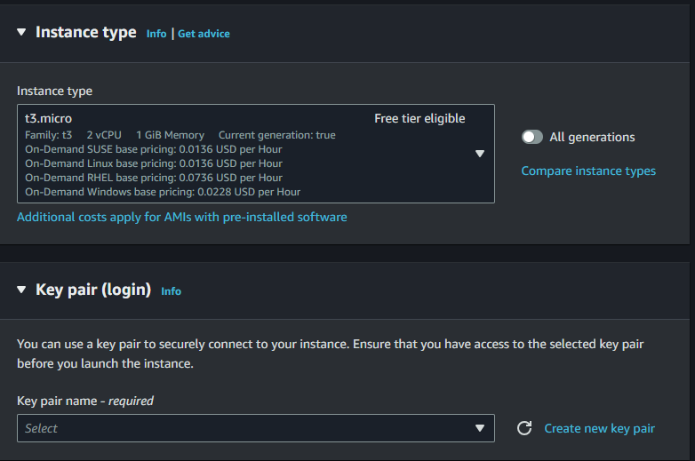
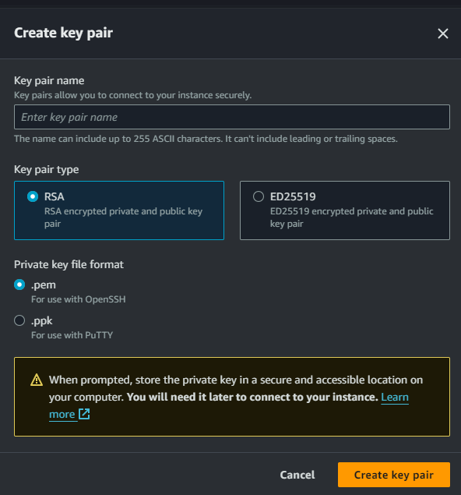
Select instance type t3.micro
Create new key pair to use when ssh the instance

Slide 37
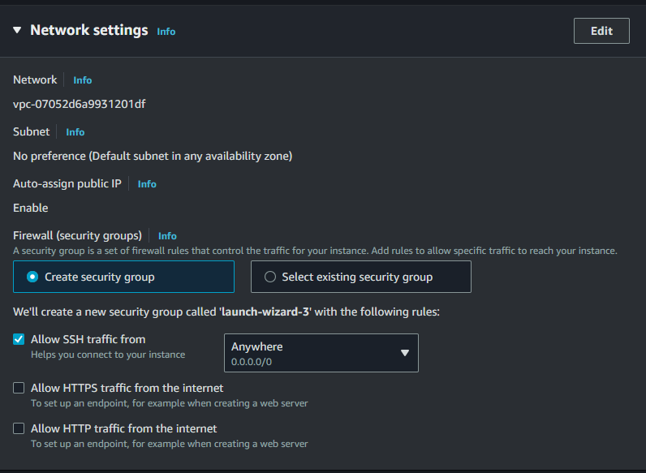
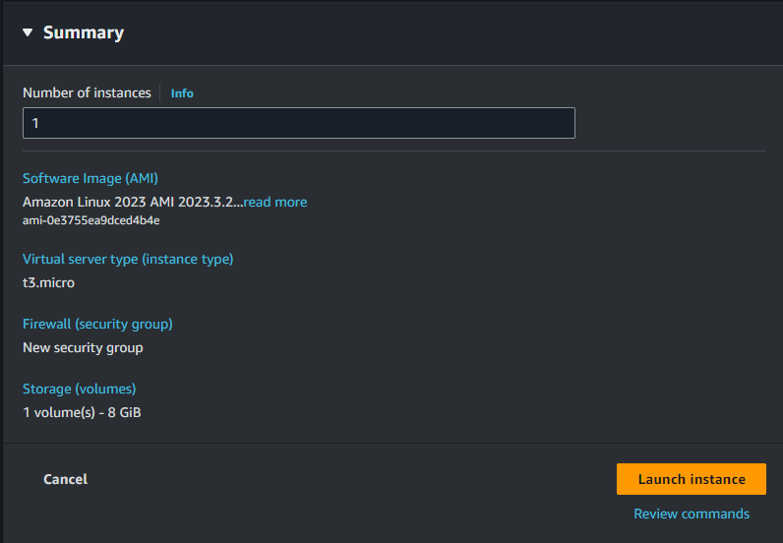
Allow SSH traffic from anywhere
SSH allow you to remote install node-red on instance on AWS
Launch Instance

Slide 38
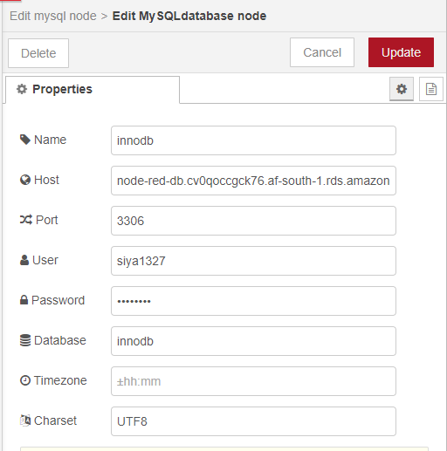

Configuring Database

Slide 39

Access instance
SSH stands for Secure Shell, and it is a Encryption network protocol used for secure communication over an unsecured network. SSH is commonly used for remote access to a computer or server, allowing users to log in and execute commands on a remote machine as if they were physically present at that machine.
So, to ssh our instance we need our ubuntu sever on the instance on AWS we need client or use PowerShell on windows.
Download bitvice for ssh on https://www.bitvise.com/download-area
Install it.

Slide 40


SSH Ubuntu Server
Public iPv4 address of instance
Keypair
Port number
username
Client key manager to import keypair from AWS
Initial method select publickey
Save profile and login

Slide 41


Successful connected to AWS instance using SSH

Slide 42



Using PowerShell
Click connect
Copy command and paste on PowerShell

Slide 43




RDS database
For storing data for I used MariaDB on AWS
Install MariaDB on AWS:
RDS service

Slide 44



Database configuration
Allow public access which all database client to view data

Slide 45


Security groups
Click RDS instance on security and edit security groups

Slide 46



Viewing Data and creating Tables
Database client to view data is used
Download DbGate on https://dbgate.org/download/
Install it
GbGate new connection:
Server which is Endpoint found on RDS database
Username
Password
Username and password are the one created on database creation.

Slide 47


Creating Tables for Database

Slide 48

Getting data from RDB on AWS

Slide 49



Decoding Data

Slide 50
Example code for sending data to TTN from Lora32 TTGO
#include <TTN_esp32.h> #include "TTN_CayenneLPP.h"
const char* devEui = "70B3D57ED8002623"; const char* appEui = "0000000000000000"; const char* appKey = "21C85D2B570030DD3D5F05BB1B770706";
TTN_esp32 ttn; TTN_CayenneLPP lpp; void message(const uint8_t* payload, size_t size, uint8_t port, int rssi) {
Serial.println("-- MESSAGE");
Serial.printf("Received %d bytes on port %d (RSSI=%ddB) :", size, port, rssi);
for (int i = 0; i < size; i++) {
Serial.printf(" %02X", payload[i]);
}
Serial.println();
}
CayenneLPP Library is used to send data to TTN and is has its own formatter

Slide 51
CONT…
void setup() {
Serial.begin(115200);
Serial.println("Starting");
ttn.begin();
ttn.onMessage(message);
ttn.join(devEui, appEui, appKey);
Serial.print("Joining TTN ");
while (!ttn.isJoined()) {
Serial.print(".");
delay(500);
}
Serial.println("\njoined !");
ttn.showStatus();
}

Slide 52
CONT…
void loop() {
float temperature = random(30, 40);
float x = random(0, 100); // Generate random X value between 0 and 100
float y = random(0, 100); // Generate random Y value between 0 and 100
x = round(x * 100.0) / 100.0;
y = round(y * 100.0) / 100.0;
lpp.reset();
lpp.addTemperature(1, temperature);
lpp.addAnalogInput(1, x); // Use Cayenne LPP analog input type for X
lpp.addAnalogInput(2, y); // Use Cayenne LPP analog input type for Y
if (ttn.sendBytes(lpp.getBuffer(), lpp.getSize())) {
Serial.printf("Temp: %f X: %f Y: %f\n", temperature, x, y);
} delay(10000);
}

Slide 53

END

